Slide 1
Motor Wiring Layout

Slide 2
Block Diagram for Connection
Power Supply
24V
Tension
Sensor
Load Cell Amplifier
NI MyRio
Controller
Escon 70/10 Servo Controller
Motor
Power Supply
Computer
Encoder

Slide 3
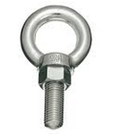
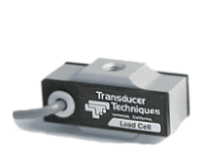
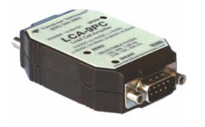
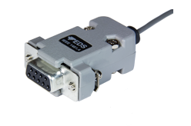


Tension Sensor to Load Cell Amplifier
To Frame
To Motor

Slide 4
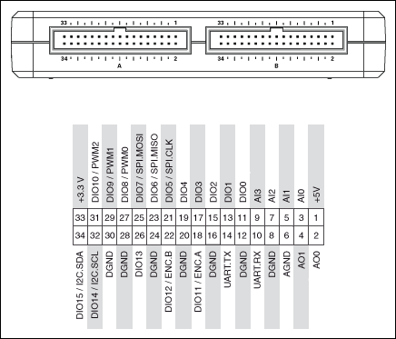
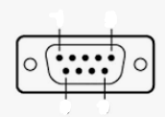
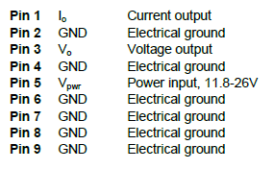

Amplifier to MyRio
NI MyRio Controller
Power Supply
24V
+
-
$$V_{0}$$
5
1
9
6
Female pin
Ground

Slide 5
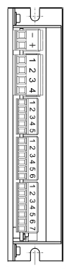
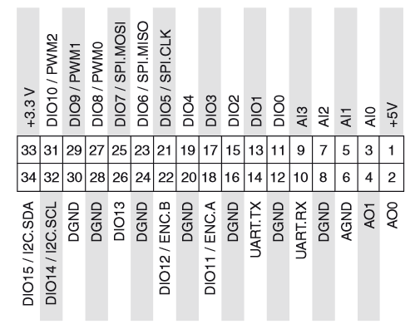

MyRio to Escon 70/10
Power Supply
24V
-
Motor Wires
+
Motor
Escon 70/10
Servo
Controller
Hall sensor wires
NI MyRio
Controller
Ground
Motor Direction
Motor Enable
FSR Input
$$V_{0}$$
Ground
Output Voltage

Slide 6
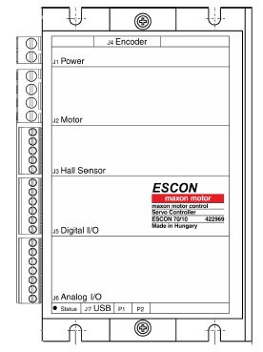
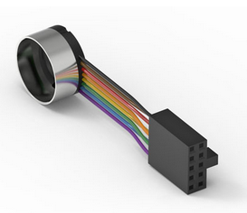
Encoder to Escon 70/10
Encoder ribbon from motor

